Slide 1
Elite Hotel Reservation & Management System
Mini Project Interim SRS Presentation – Group 12
Prepared by: S.Saraniya
A.Kanistan
K.Kavin Krishanth
G.Lakshana
T.Nidhurgayani
Supervisor: Dr. Navod Neranjan
Notes:
Good morning respected lecturers. We are Group 12 from the Faculty of Technology. Today we will present our System Requirements Specification for the Elite Hotel Reservation and Management System.

Slide 2
Introduction
Web-based platform for hotel bookings and management.
Replaces manual operations with secure, automated processes.
Improves accuracy, efficiency, and customer satisfaction.
Notes:
This system allows hotel guests to book rooms, reserve buffet slots, and schedule reception halls online. Admins manage everything through a dashboard.

Slide 3
Purpose
Enable online booking of rooms, buffets, and halls.
Develop an integrated, user-friendly, web-based platform for hotel booking & management.
Notes:
The purpose is to simplify booking processes for customers and give hotel staff efficient tools to manage operations.

Slide 4
Overall System Description
Self-contained web-based system with centralized database
Frontend: React.js, HTML, CSS
Backend: Node.js + PHP
Database: PostgreSQL
APIs: Stripe/Razorpay, Twilio, SendGrid
Users: Guests and Admins
Notes:
Key terms and acronyms used in the project documentation.

Slide 5
Constraints
Must work on mobile and desktop.
Requires secure authentication.
Follows secure coding standards.
Notes:
Requirements that limit or guide system implementation.

Slide 6
Functional Requirements
Room Booking: search, availability, modify/cancel.
Buffet Reservation: meal slots, dietary options.
Hall Booking: services customization.
User Management: register, profile, password reset.
Admin Dashboard: manage reservations, reports.
Payment & Billing: secure payment, invoicing.
Notifications: SMS/email confirmations.
Notes:
Features and capabilities that the system must have.

Slide 7
Non-Functional Requirements
Performance: 100 concurrent users, <2s response.
Security: HTTPS, encryption, role-based access.
Usability: mobile responsive, tooltips, simple navigation.
Reliability: 99.5% uptime, daily backups.
Portability: works on all devices and browsers.
Notes:
Standards for system operation and quality.

Slide 8
Use Case Diagram
Shows interaction between Guests, Admin, Receptionist, Staff.
Main use cases: Book Room, Buffet, Manage Menu, Check-in/Check-out, Customize Hall, Feedback.
Notes:
Overview of system-user interactions.

Slide 9
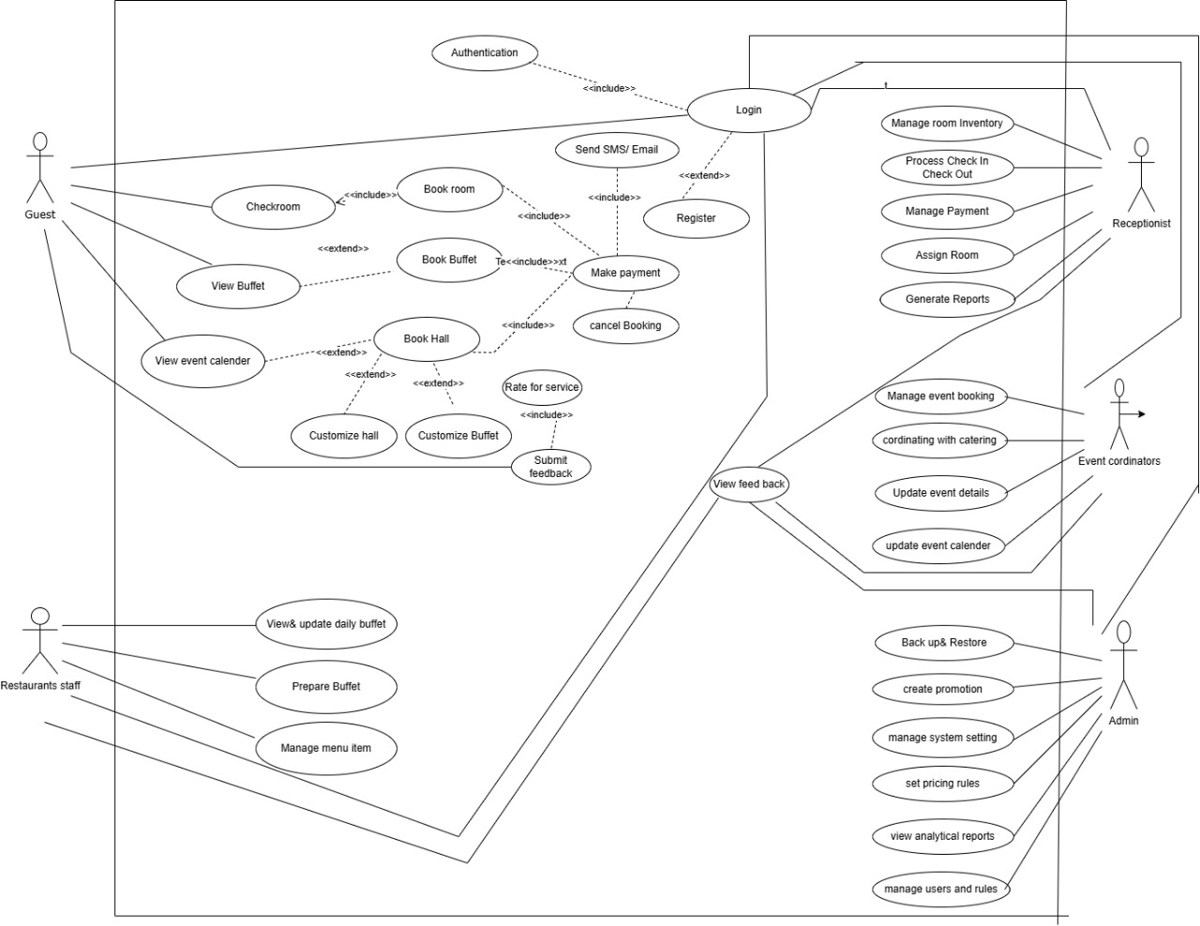
Our system Use case diagram

Slide 10
UI/UX Features
User-friendly and responsive design
Booking summary and history view
Admin dashboard with real-time updates
Notifications via SMS and Email
Notes:
Connections between system and external components.

Slide 11
Project Progress & Completeness
Modules implemented: Room booking, Buffet reservation
Modules in progress: Admin dashboard, user Dash board , Staff dash board Payment & Notifications
Notes:
Technical boundaries of the system.

Slide 12
Demonstration Plan
Admin Dashboard demo
User Dashboard demo
Staff Dashboard demo
Room Booking Module demo
Buffet Reservation demo
Hall Booking demo
Notes:
Final summary and closing remarks.

Slide 13
Challenges & Constraints
Stable internet requirement
Secure authentication implementation
Optimizing system performance

Slide 14
Future Enhancements
Multi-language support
Mobile app integration
Advanced analytics and reporting

Slide 15
Conclusion
System is nearly complete and functional.
Our project is implemented as per the SRS document and Use case diagram.
Customer satisfaction and operational efficiency.

Slide 16
Thank you

